Slide 1
Deques
A double-ended queue (or deque) is a queue that supports enqueue and dequeue operations at both the front and rear of the queue:
enqueue_f, enqueue_r
dequeue_f, dequeue_r
Linked list implementation of a deque:
typedef struct linkedlist2 {
Node *head;
Node *tail;
int listSize;
} LinkedList2;
head
tail
dequeue_f
head = head->next
enqueue_r
tail->next =
new node
enqueue_f
p = new node
p->next = head
head = p

Slide 2
Linked list implementation: dequeue_r
void dequeue_r(LinkedList2 *dq, int *ans) {
if(dq == NULL || dq->head == NULL) { return; }
Node *p = dq->head; Node *q = dq->tail;
if(p == q) {
dq->head = dq->tail = NULL;
} else {
while(p->next != q) { p = p->next; }
p->next = NULL;
dq->tail = p;
}
dq->listSize--;
if(ans != NULL) { *ans = q->data; }
free(q);
}
O(n)

Slide 3
Faster implementation: doubly linked lists
typedef struct dllnode {
int data;
struct dllnode *prev;
struct dllnode *next;
} DLL_node;
We can now implement a deque as follows:
typedef struct deque {
DLL_node *head;
DLL_node *tail;
int size;
} Deque;

Slide 4
Fill in the details!
DLL_node *makeDLL_node(int, DLL_node *, DLL_node *);
Deque *enqueue_f(Deque *dq, int data) {
DLL_node *p = makeDLL_node(data, NULL, NULL);
if(p == NULL) { return NULL; }
if(dq == NULL) {
dq = (Deque *) malloc(sizeof(Deque));
if(dq == NULL) { free(p); return NULL; }
dq->head = dq->tail = p; dq->size = 1;
} else {
if(dq->head == NULL) { dq->head = dq->tail = p; }
else {
p->next = dq->head;
dq->head->prev = p;
dq->head = p;
}
dq->size++;
}
return dq;
}

Slide 5
One more!
void dequeue_r(Deque *dq, int *ans) {
if(dq == NULL || dq->head == NULL) { return; }
DLL_node *q = dq->tail;
if((dq->tail = q->prev) == NULL) {
dq->head = NULL;
}
dq->size--;
if(ans != NULL) { *ans = q->data; }
free(q);
}

Slide 6
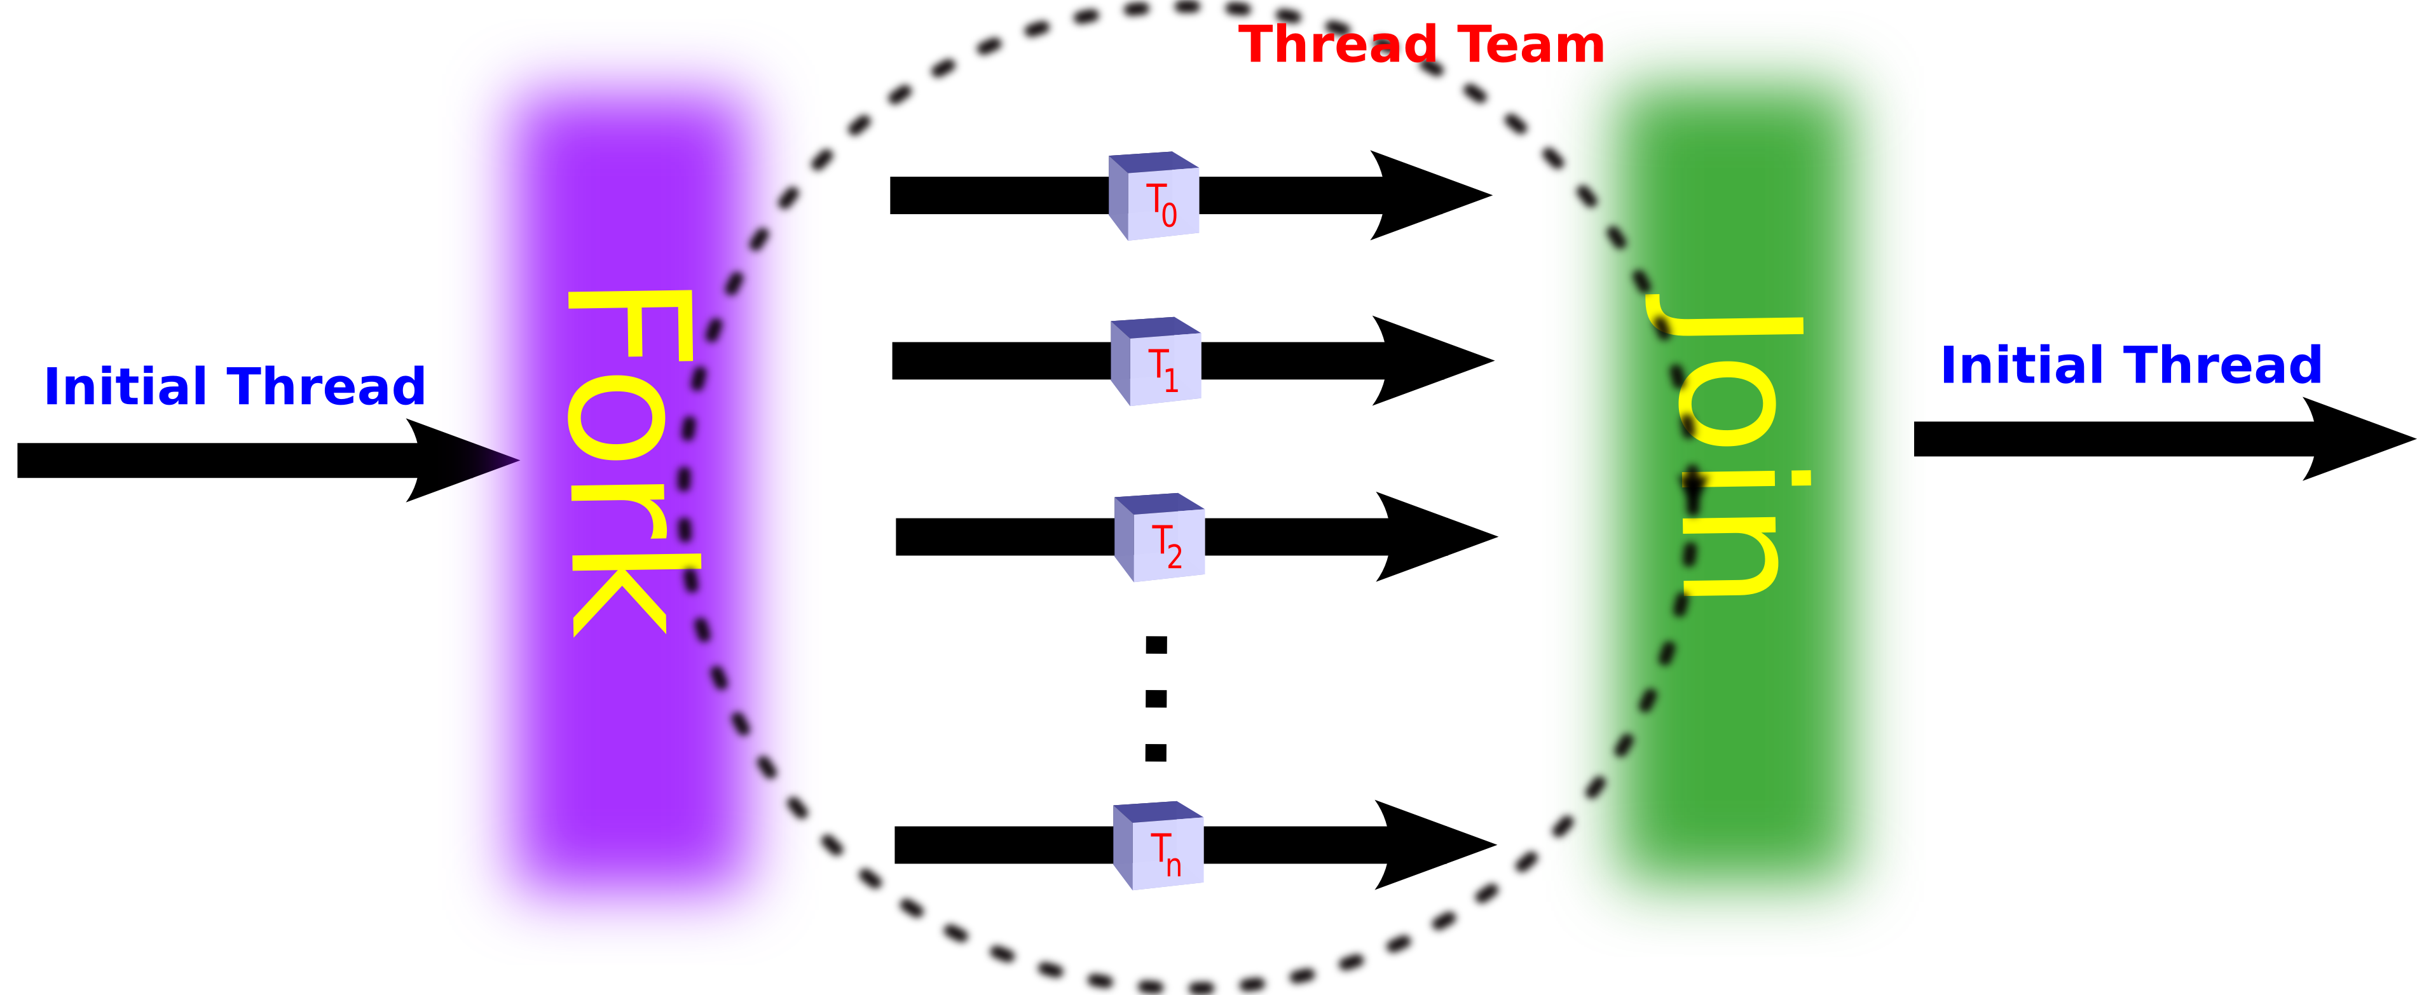
An interesting application: Work stealing
:
for(i = 0; i < N; i++) {
a[i] = f(i); // f() is an expensive computation
}
:
Key idea: If possible, share expensive work across multiple processors
:
parallel_for(i = 0; i < N; i++) {
a[i] = f(i);
}
:
Fork-join model:
Task scheduler needs to
assign iterations to processors
6

Slide 7
Sharing the workload
:
for(i = 0; i < N; i++) {
a[i] = f(i); // f() is an expensive computation
}
:
Naïve strategy: Split the iterations evenly among processors
e.g., if there are 4 processors P₁, P₂, P₃, P₄ then
does very poorly if some iterations take much longer than others
Task scheduler cannot predict this!
Even if it could, finding the optimal split is NP-hard
0 | N/4 | N/2 | 3N/4
P₁
P₂
P₃
P₄
7

Slide 8
Work-Stealing Heuristic
Each available processor will maintain a deque of tasks (sub-ranges)
P₁’s deque:
P₁ processes its deque bottom-up
if P₁ done, it steals from top of P_{random}’s deque
An improvement:
0 | N/4 | N/2 | 3N/4
P₁
P₂
P₃
P₄
0
N/8
3N/16
0
N/8
N/16
0
≤ grainsize
0
N/8
N/8
0
N/16
0

